Slide 1
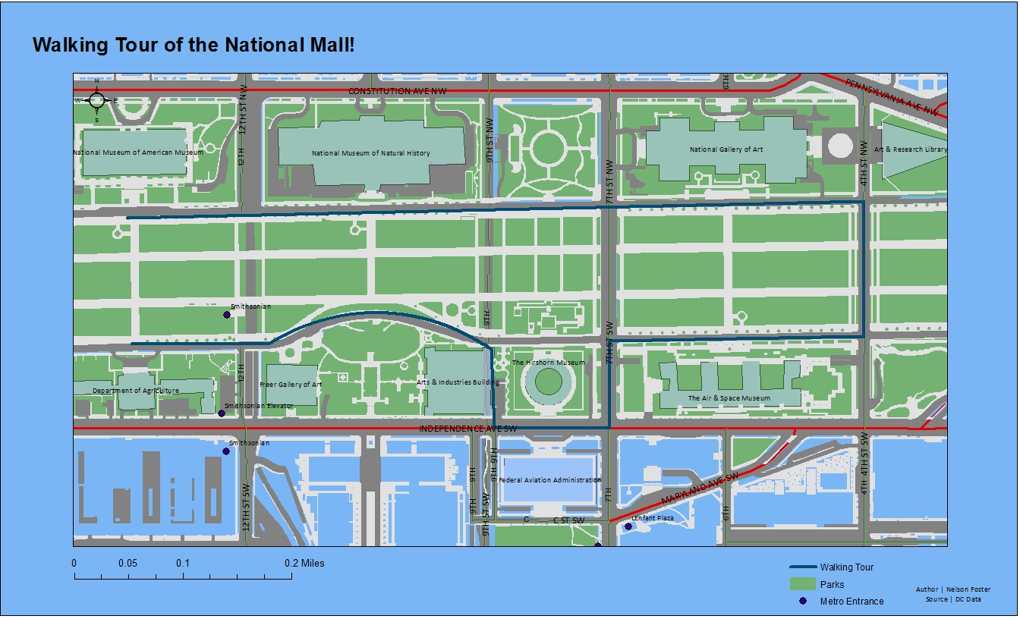
Blue background not great, looks like water and kind of overwhelms the viewer
Digitization is decent, some crookedness though
What re the green and red lines in the streets?
Lots of space around the edge of the map, could make it a bit bigger and show more detail that way
Good idea to put the other map elements along the bottom
Need date too

